Slide 1
Lab 2 Energy efficient image processing

Slide 2
Objective and organization
Demonstrates how manipulation of an image can be used to tradeoff image quality to save power in emissive displays
1 report – 2 days
Matlab
Organize all implemented methods in functions and scripts to automatically test and evaluate all images and all techniques

Slide 3
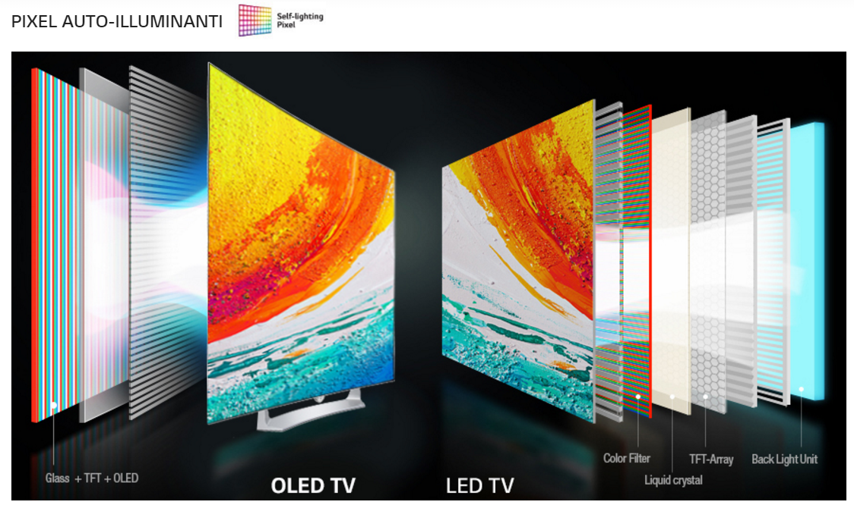
OLED vs LED
OLED TVs
Do not require external lighting
Better black levels

Slide 4
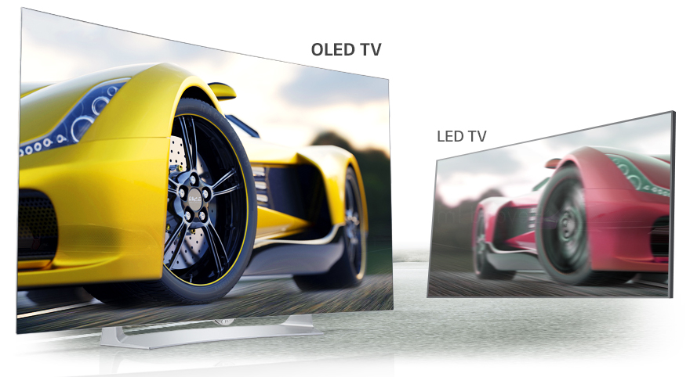
OLED vs LED
OLED TVs
Pixels are independent from each other
More sense of depth
Higher contrast makes images more realistic

Slide 5
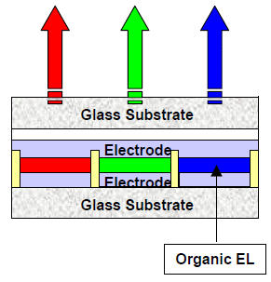
OLED
Interesting case study from our perspective…
Organic light-emitting diode (OLED)
Do not require external lighting
Pixels are emissive
Emissive layer is a film of organic compound which emits light in response to an electric current
Each pixel is made of three devices corresponding to red, green and blue components

Slide 6
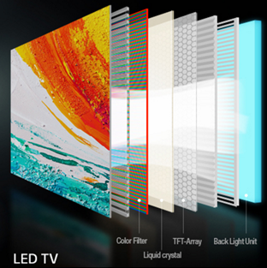
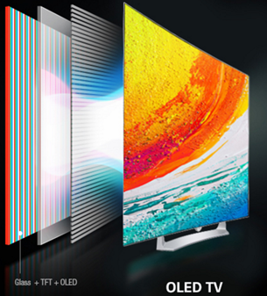
OLED
In LCDs, backlight dominates power consumption and color has only negligible power impact
With OLED displays, the color of a pixel impacts on power consumption
E.g., hungry blue
Different luminance efficacies
Different images imply different power consumption

Slide 7
OLED
Power consumption depends on color components of a pixel…
So we can save power by changing the spectrum of the image!
First class of power saving methods:
Change pixel color
Given a certain tolerance level on color distorsion

Slide 8
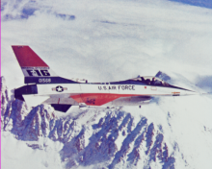
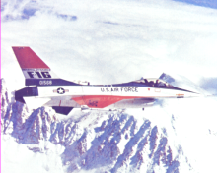
Compute power consumption
Evaluate the power consumption / image distortion tradeoff
Apply image transformation
Compute distortion
Compute power consumption

Slide 9
Assignment 1

Slide 10
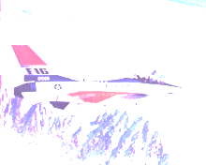
Compute power consumption
Evaluate the power consumption / image distortion tradeoff
Apply RGB-base distortions
Compute distortion
Compute power consumption

Slide 11
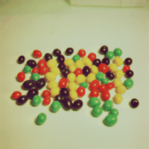
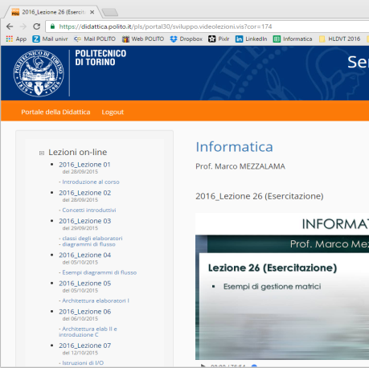
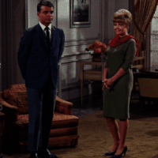
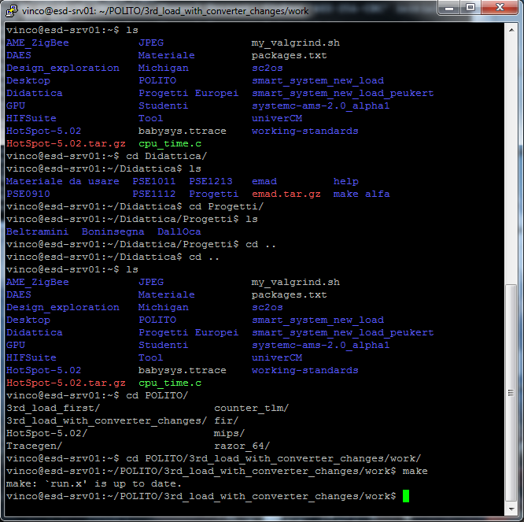
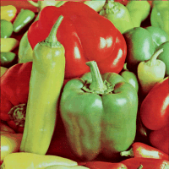
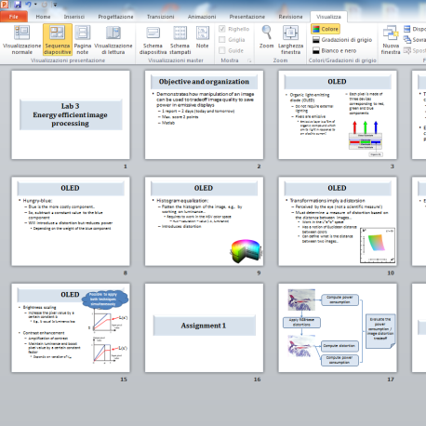
1. Identification of images
Test images will be:
10 color images from the USC SIPI database
http://sipi.usc.edu/database/database.php?volume=misc
5 images representing different screenshots of your computer
Different colors and characteristics…

Slide 12
2. Manipulation of images
Experiments require to adopt different color spaces…
TASK: Learn how to:
Import the image
imread() function
Extract the R, G, B channels
Convert between different color spaces
Refer to:
http://it.mathworks.com/help/images/index.html

Slide 13
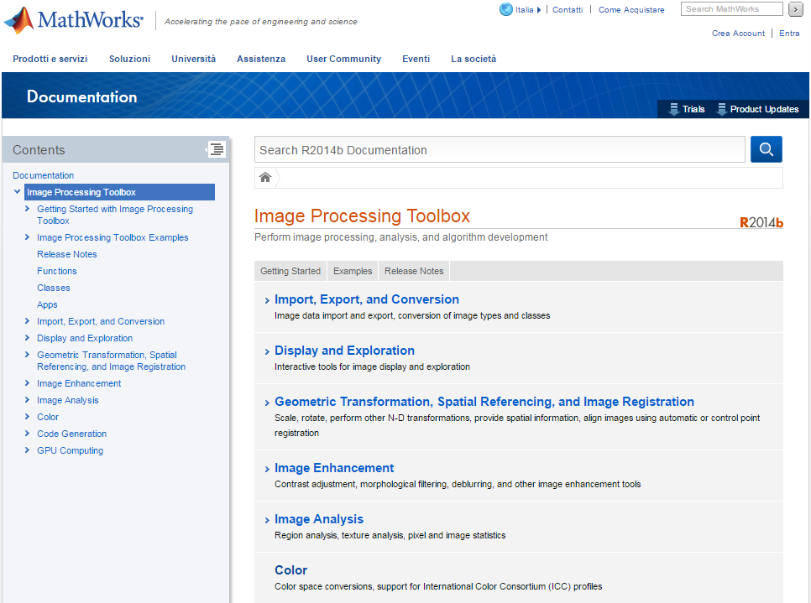

Slide 14
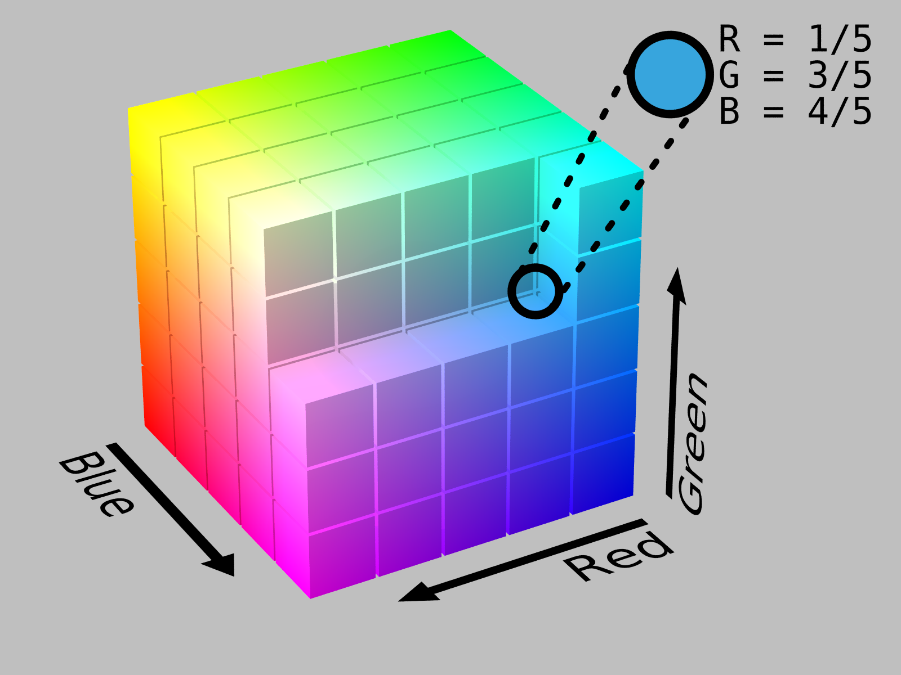
2. Manipulation of images
RGB
Additive color space
All possible colors that can be made from three colorants for red, green and blue
Stores individual values for red, green and blue
Convenient color model for computer graphics as it is similar to the human visual system
Used in LCDs

Slide 15
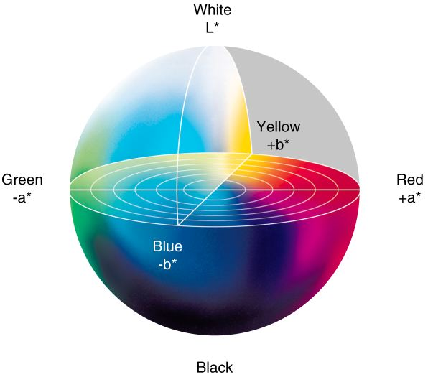
2. Manipulation of images
Lab
One channel for luminance (L) and two color channels (a and b)
Includes all perceivable colors
Super-set of RGB
The space is a three-dimensional Real number space
Allows the definition of Euclidean distance

Slide 16

2. Manipulation of images
HSV
Hue
Perceived color
Saturation
Colorfulness, amount of white component
Value
Brightness
Cylindrical-coordinate representations of points in an RGB color model
Widely used in computer graphics

Slide 17
Compute power consumption
Evaluate the power consumption / image distortion tradeoff
Apply RGB-base distortions
Compute distortion
Compute power consumption

Slide 18
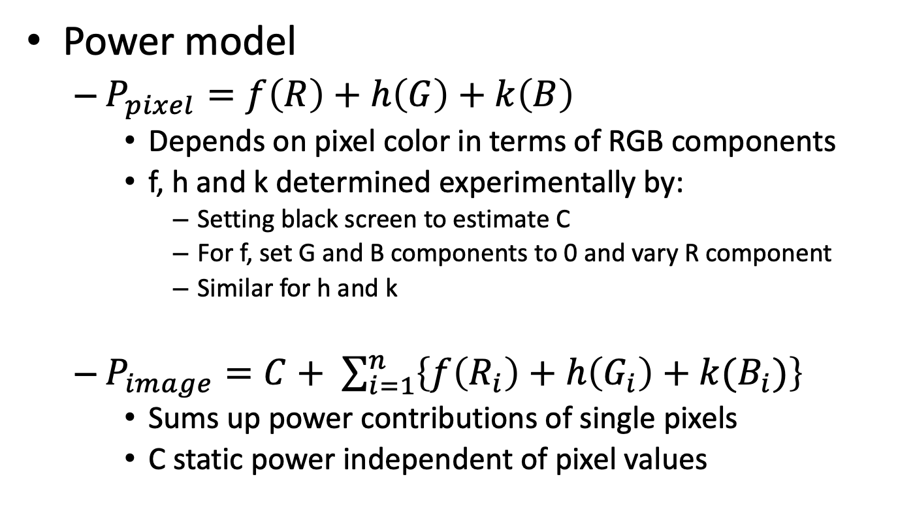
3. Evaluation of power consumption
Power model
$P_{pixel}=f\left(R\right)+h\left(G\right)+k\left(B\right)$
Depends on pixel color in terms of RGB components
f, h and k determined experimentally by:
Setting black screen to estimate C
For f, set G and B components to 0 and vary R component
Similar for h and k
$P_{image}=C+ \sum_{i=1}^{n}{\left\{f\left(R_{i}\right)+h\left(G_{i}\right)+k(B_{i})\right\}}$
Sums up power contributions of single pixels
C static power independent of pixel values

Slide 19
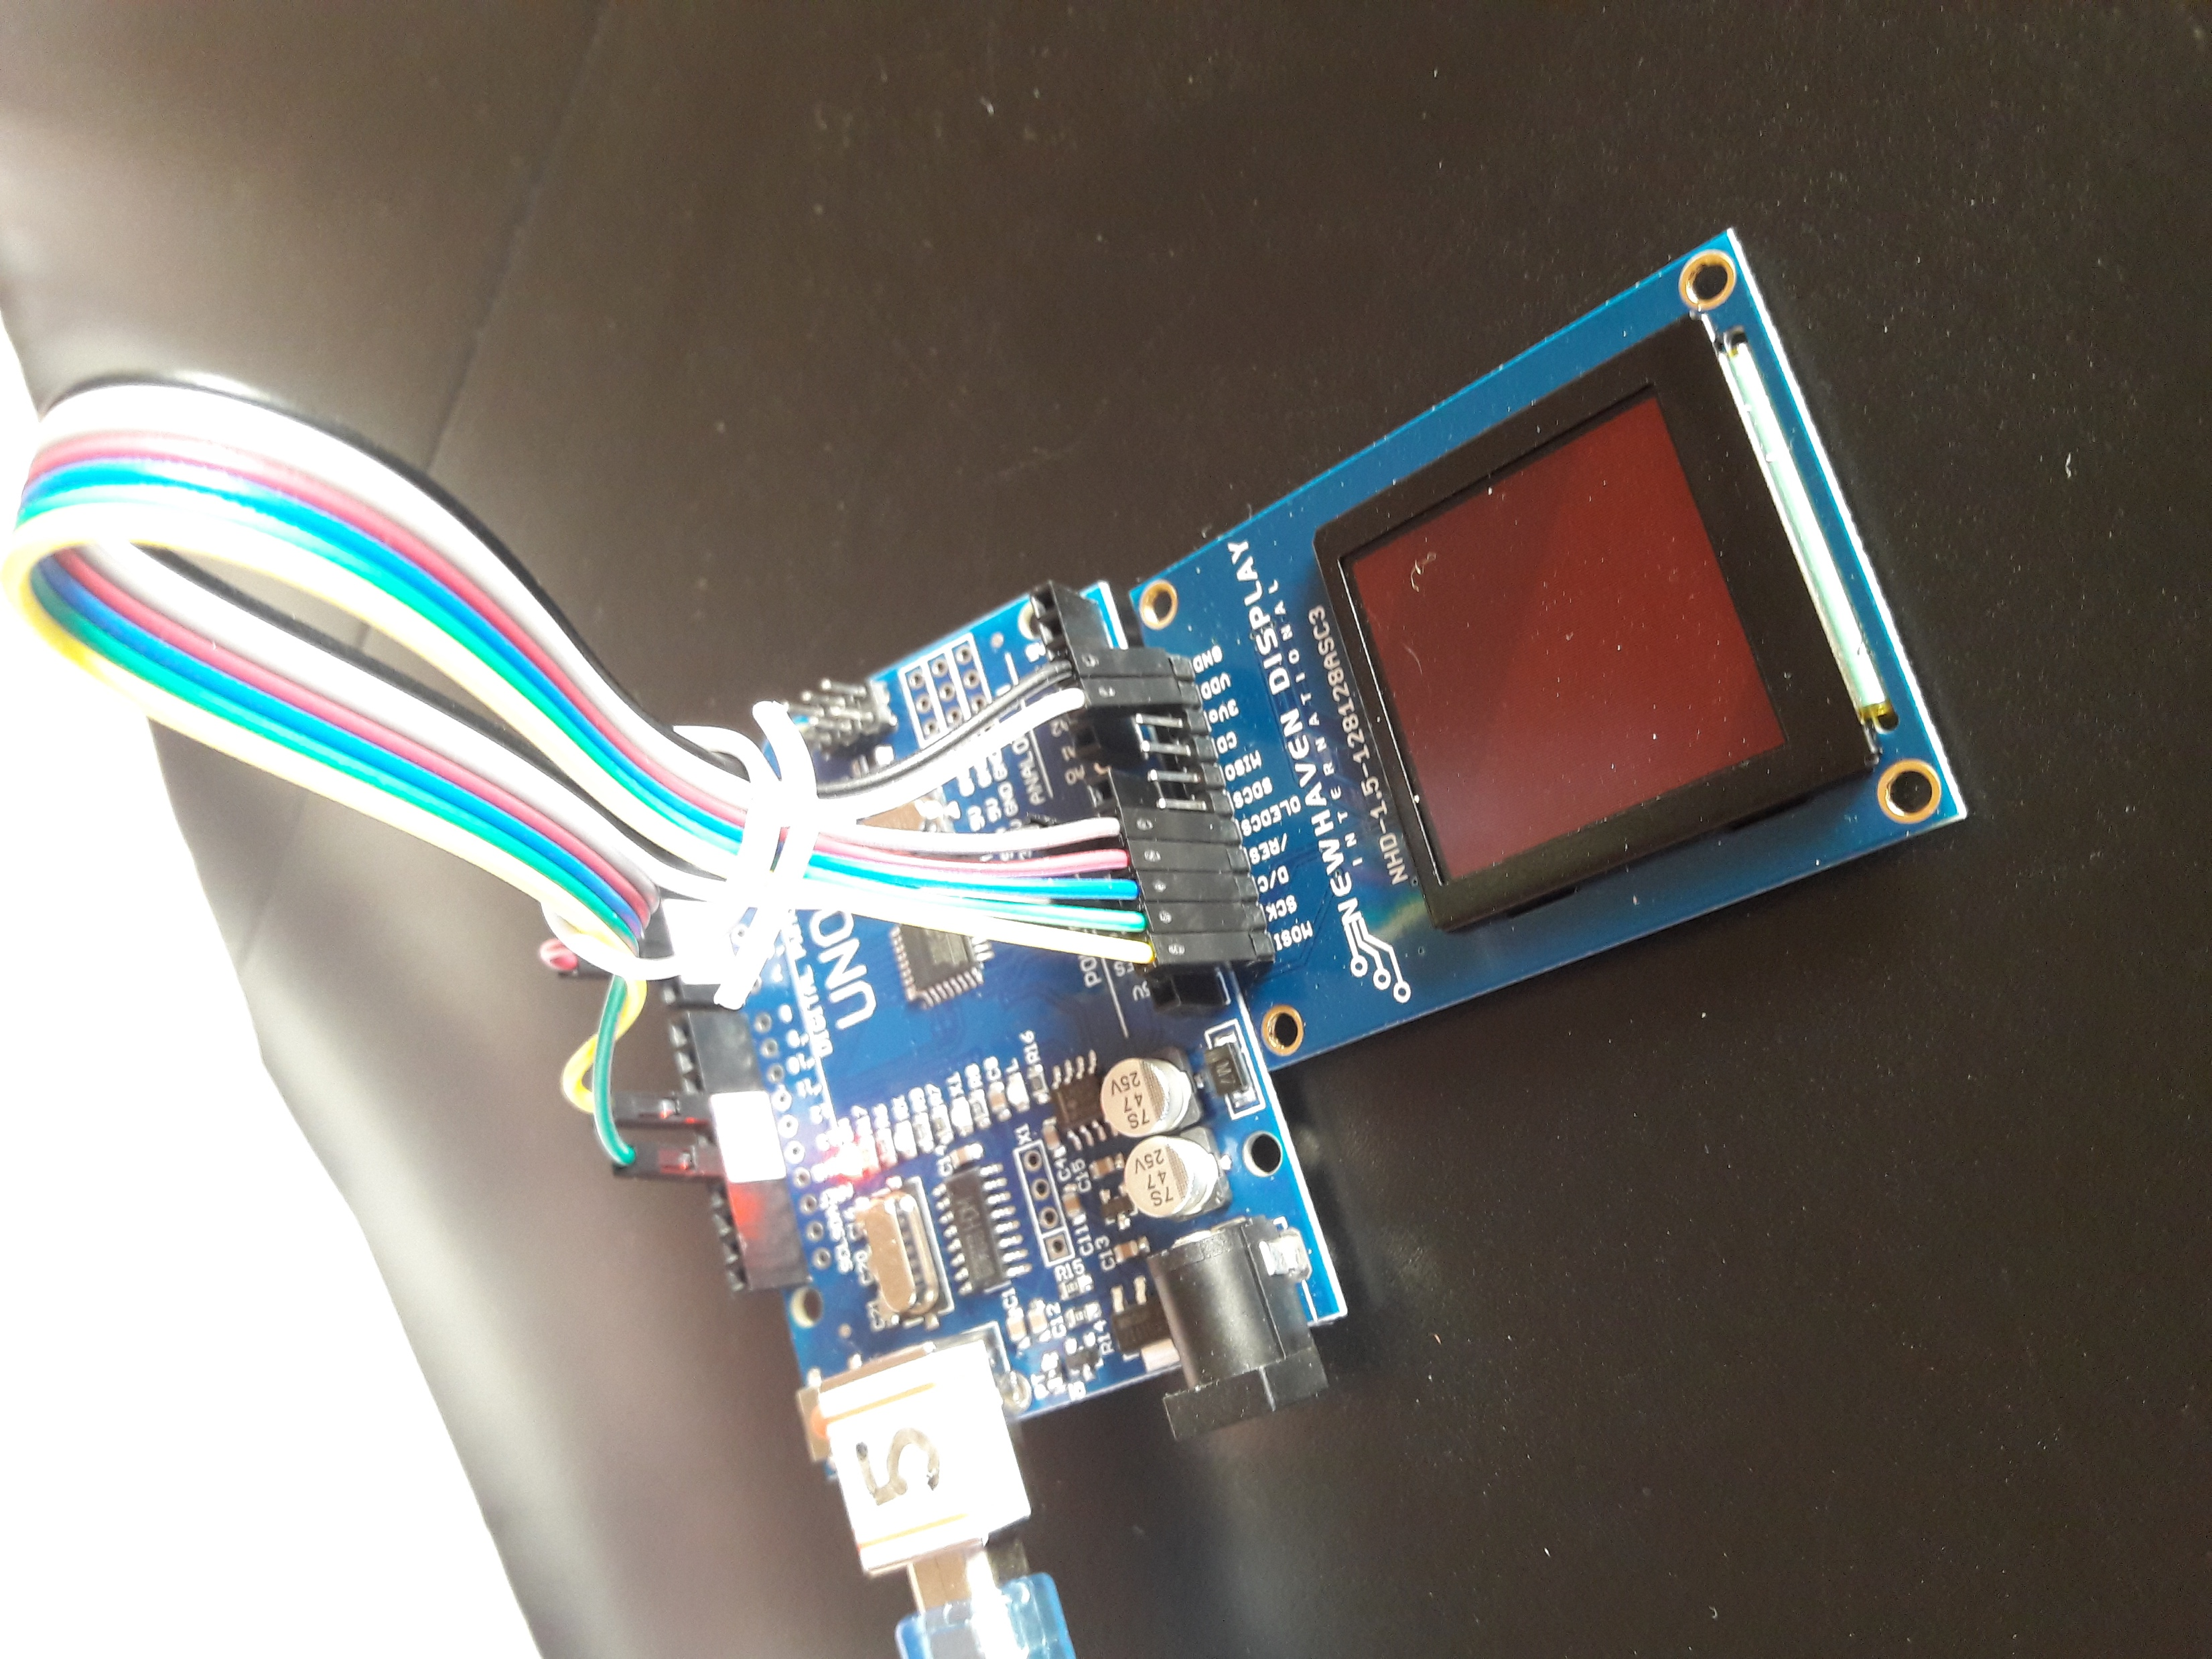
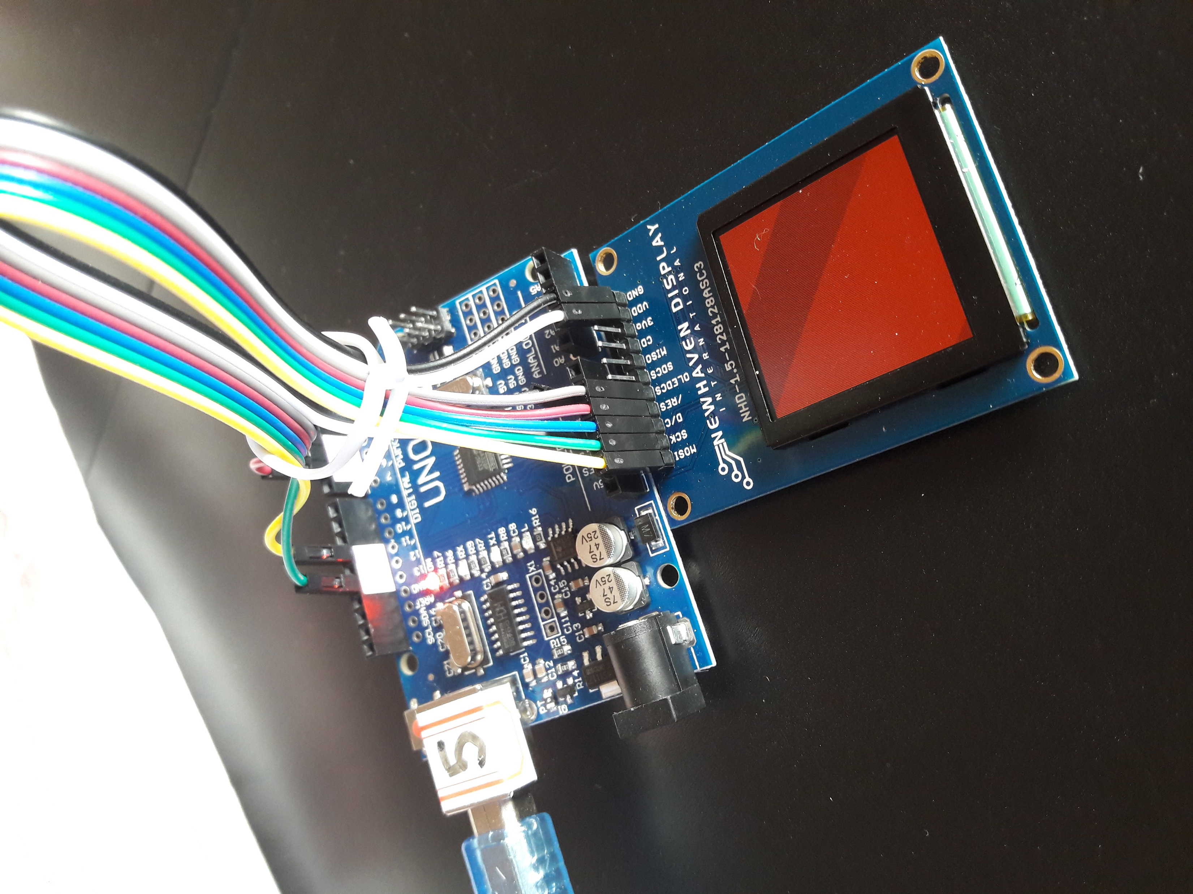
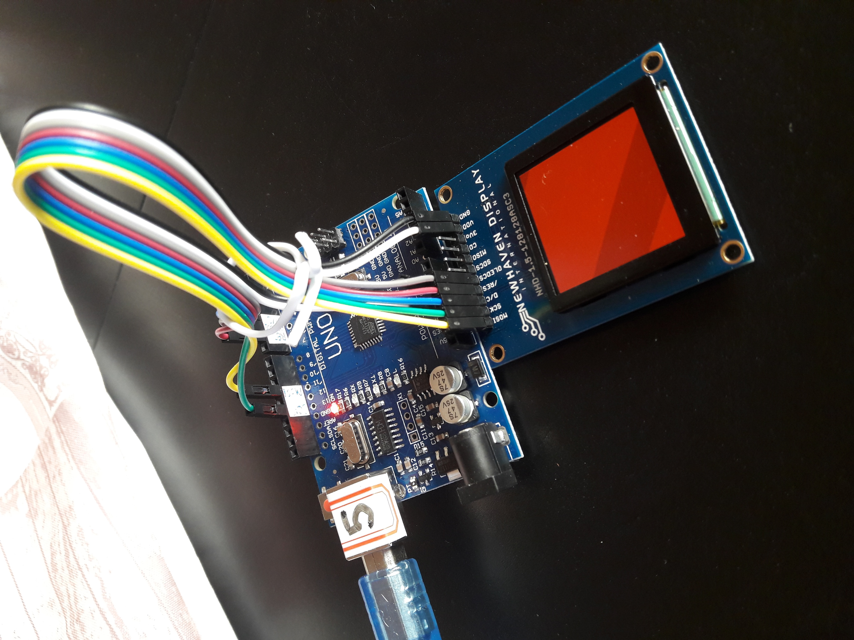
1. Evaluation of power consumption
Experimental Setup:
Show monochromatic images with different RGB values on the OLED, e.g.:
Measure power supply current (and convert to power)

Slide 20
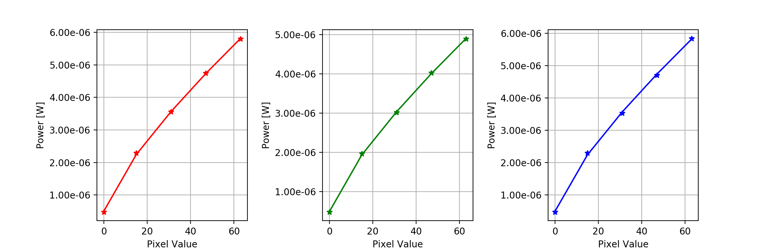
1. Power model for the provided OLED (cont’d)
Interpolation:
Find regression model type that fits best the data and determine the corresponding parameters
For this Lab, we used a model format from literature (see next slide)

Slide 21
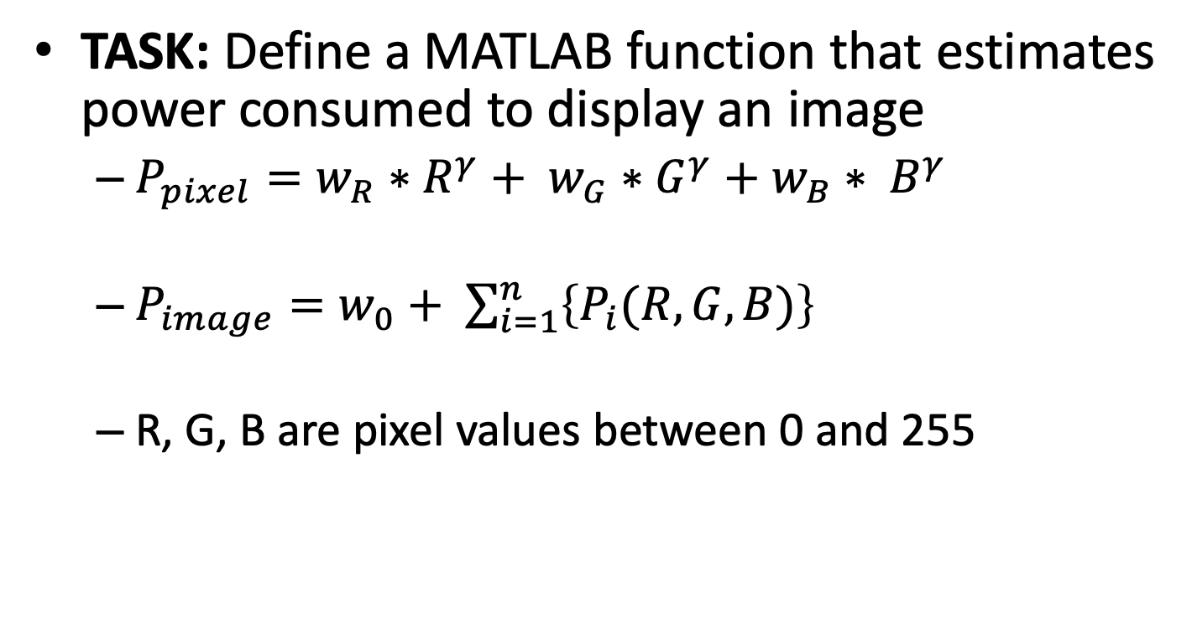
3. Evaluation of power consumption
TASK: Define a MATLAB function that estimates power consumed to display an image
$P_{pixel}=w_{R}∗R^{γ}+ w_{G}∗G^{γ}+w_{B}∗ B^{γ}$
$P_{image}=w_{0}+ \sum_{i=1}^{n}{\left\{P_{i}(R, G, B)\right\}}$
R, G, B are pixel values between 0 and 255
γ | W₀ | W_{R} | W_{G} | W_{B}
0.7755 | 1.48169521*10⁻⁶ | 2.13636845*10⁻⁷ | 1.77746705*10⁻⁷ | 2.14348309*10⁻⁷

Slide 22
Compute power consumption
Evaluate the power consumption / image distortion tradeoff
Apply RGB-base distortions
Compute distortion
Compute power consumption

Slide 23
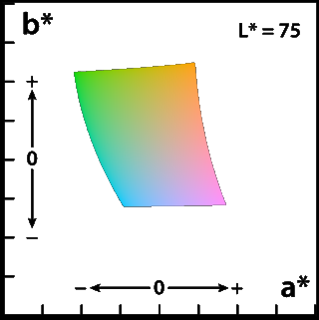
4. Evaluation of image distortion
Transformations imply a distorsion
Perceived by the eye (not a scientific measure!)
Must determine a measure of distortion based on the distance between images…
Work in the L*a*b* space
Has a notion of Euclidean distance between colors
Can define what is the distance between two images..

Slide 24
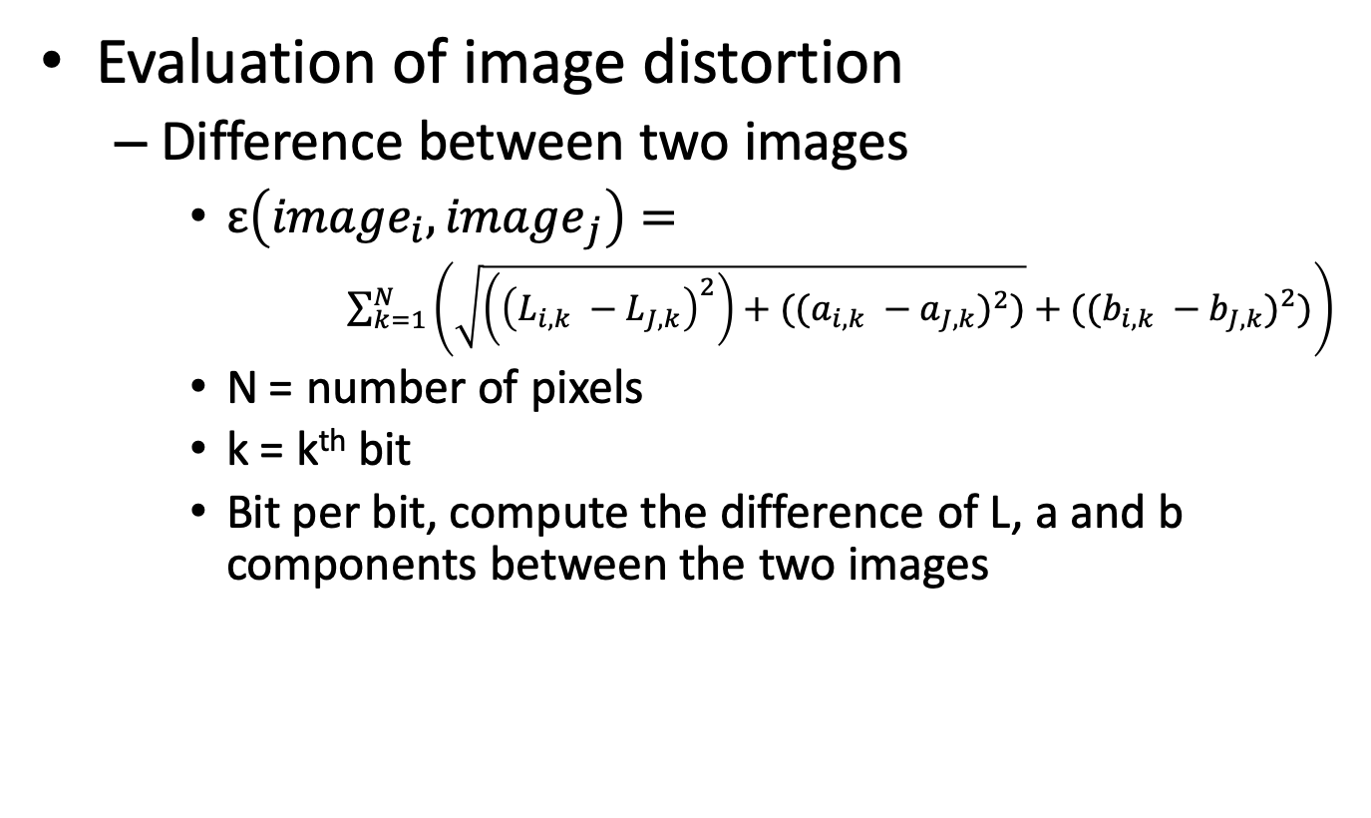
4. Evaluation of image distortion
Evaluation of image distortion
Difference between two images
$ε\left({image}_{i},{image}_{j}\right)=$
$\sum_{k=1}^{N}{\left(\sqrt{\left({\left(L_{i,k} −L_{J,k}\right)}^{2}\right)+({(a_{i,k} −a_{J,k})}^{2})}+({(b_{i,k} −b_{J,k})}^{2})\right)}$
N = number of pixels
k = k^{th} bit
Bit per bit, compute the difference of L, a and b components between the two images

Slide 25
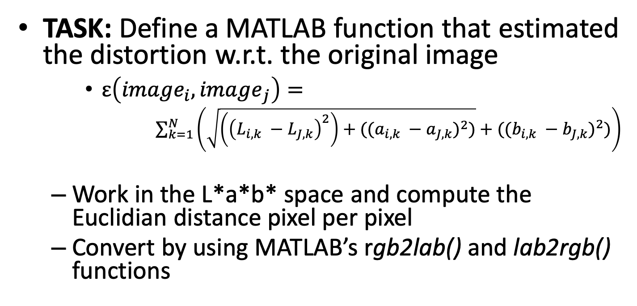
4. Evaluation of image distortion
TASK: Define a MATLAB function that estimated the distortion w.r.t. the original image
$ε\left({image}_{i},{image}_{j}\right)=$
$\sum_{k=1}^{N}{\left(\sqrt{\left({\left(L_{i,k} −L_{J,k}\right)}^{2}\right)+({(a_{i,k} −a_{J,k})}^{2})}+({(b_{i,k} −b_{J,k})}^{2})\right)}$
Work in the L*a*b* space and compute the Euclidian distance pixel per pixel
Convert by using MATLAB’s rgb2lab() and lab2rgb() functions

Slide 26
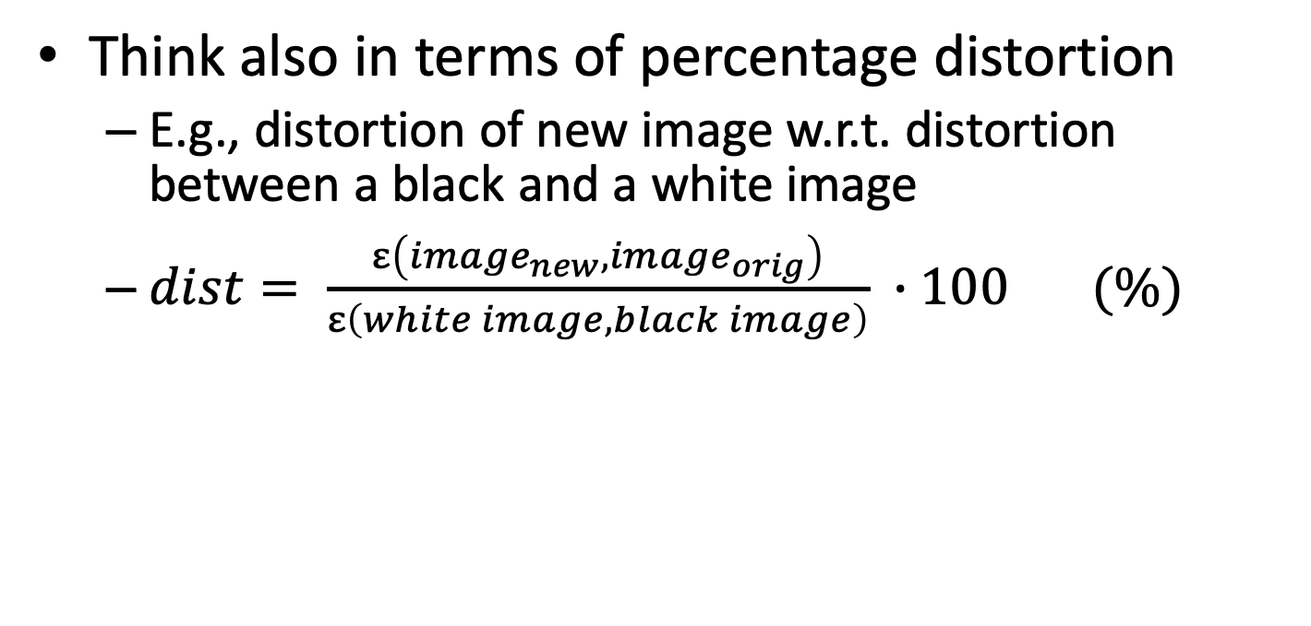
4. Evaluation of image distortion
Think also in terms of percentage distortion
E.g., distortion of new image w.r.t. distortion between a black and a white image
$dist= \frac{ε\left({image}_{new},{image}_{orig}\right)}{ε\left(white image, black image\right)} ∙100 (\%)$

Slide 27
4. Evaluation of image distortion (cont’d)
Alternative: Mean Structural Similarity Index (MSSIM).
More complex metric involving measures of brightness, contrast and structural distortion
Implementation provided by MATLAB: ssim(A, B)
Score between 0 and 1 (1 = identical images).
Convert to % simply by multiplying * 100
TASK: Compare the two distortion metrics and determine which one correlates better with visual differences

Slide 28
Compute power consumption
Evaluate the power consumption / image distortion tradeoff
Apply RGB-base distortions
Compute distortion
Compute power consumption

Slide 29
5. Evaluation of various strategies on image modification
TASK: Experiment image manipulation strategies to reduce power consumption:
Pixel-wise transformations
Work on colors
Histogram equalization
Work on luminance
Other types of brightness/contrast modifications
Apply to all images

Slide 30
5. Evaluation of various strategies on image modification
Hungry-blue:
Blue is the more costly component..
So, subtract a constant value to the blue component
Will introduce a distortion but reduces power
Depending on the weight of the blue component
Histogram equalization:
Flatten the histogram of the image, e.g., by working on luminance…
Requires to work in the HSV color space
Hue – saturation – value (i.e., luminance)
Introduces distortion
Other types of brightness/contrast transformations:
E.g. Convert to HSV and scale the value component (V → k*V with k < 1) or do some more complex transformation
use your imagination

Slide 31
Compute power consumption
Evaluate the power consumption / image distortion tradeoff
Apply RGB-base distortions
Compute distortion
Compute power consumption

Slide 32
6. Analysis
Analyse power/distortion tradeoff
Do different images behave differently?
What changes in terms of power consumption with different manipulation strategies?
How can I save more power with lower distorsions?
…
TASK: Compare the transformations you applied and find the solution that minimizes power consumption under a maximum average distortion constraint (1%, 5%, 10%)
Use both distortion metrics

Slide 33
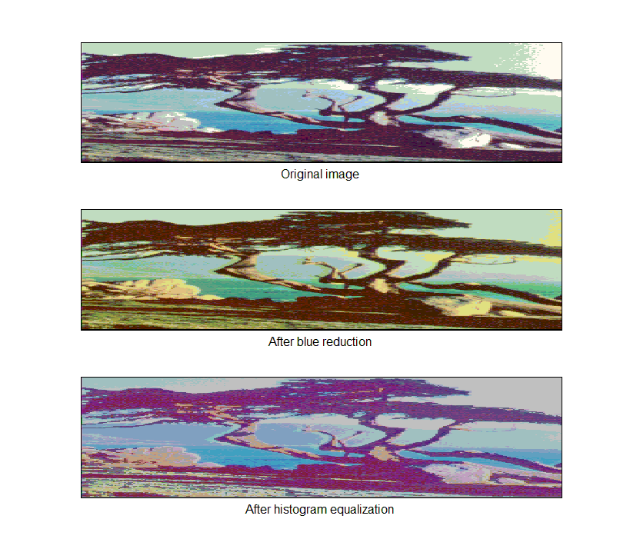
6. Analysis
Example:
Blue reduction
Power saving 29.11%
Distortion 30.99%
Histogram equalization
Power saving 11.99%
Distortion 8.46%

Slide 34
How to:
Learn how to load an image in MATLAB
And how to convert it to RGB
Write the function to estimate power consumption
Write the function to estimate distortion

